Slide 1
Week-17
Lead to Excel
Programme STD-5th
Communication And
Presentation - Part 1
Science fun-fair
Story reading with rhythm
Map reading
Motivational videos

Slide 2


Communication and
presentation
“Communication is a process that involves sending and receiving of messages through a verbal and Non-verbal method”
Skills for effective communication :
Be a good listener.
Be concrete and clear- specific with your message/information.
Non-verbal communication plays vital role in effective communication. Communication with the help of the Body Language. ( Tone, eye contact, facial expressions & hand gestures)
4. Don't take stress and anxiety. Be relaxed.

Slide 3
Activities:
Watch the experiment and learn to do it yourself.
Talk with non-living things. E.g. Bench, Book, Mobile.
Hello,
I am going to show you a magic today.
See this is the paper and this is the comb.
Now I am going to tear the paper into pieces.
Then I rub comb to my hair.
And just see the magic, pieces of the paper attract towards the comb.
Do you know why this happen?
This happens due to static electricity.
2) I wish I would have wings………..
3) Science-fun fair
(Ref. page 60-61 Std. 5th English textbook)

Slide 4
Emotional Development/ cultivation:
We feel very relaxed after sharing our feelings.
(E.g. happiness, sadness, anger)
Internal satisfaction and relief after expressing our positive or negative feelings.
Interaction improves relationships.
Emotional awareness helps us to know what we need.
It helps to build better relationships.
Emotional Cultivation is continuous and never ending procedure.
For Example:
Students share their tiffin with each other.
They share their bench with friends.
Makes friendship with everyone.
He/she shares incidents of the school with his/her parents.
Helps and cares others.
Feel sympathy.

Slide 5
Reading with Rhythm
‘ 7’ cases where intonation matters in English :
1) Asking questions: e.g. 1) Have you completed your homework today? ↑
2) When is your birthday? ↓
2) Making statements:
e.g. 1) Please submit your work online, if you can. ↓
3) Listing things : Items in a list use rising intonation until the final item, which uses falling intonation.
E.g. - 1) “I love chocolate, ↑ strawberry, ↑ and mango ice cream” ↓
4) Expressing feelings: High-energy emotions like happiness, excitement, fright and
annoyance usually use a rising intonation.
E.g. - “I can’t believe he gave you a ride home!”
“Wow, how beautiful the dress is!”

Slide 6
5) Stressing the importance of something:
Use rising intonation on specific words in a sentence to emphasize their importance.
e.g. - “I hope you got the red scarf.”
“I hope you got the red scarf.”
6) Contrasting between things:
Use a rising intonation and place a stress on the two things you want to contrast.
E.g. - 1) “I thought he liked dogs but he actually likes cats.”
2) “You should exercise everyday, but I know you don’t have time.
7) Using Question tags:
If you are using a question tag to clarify, your voice rises to let the listener know that you expect more information.
E.g. - You are staying in student hostel, aren’t you? ↓

Slide 7
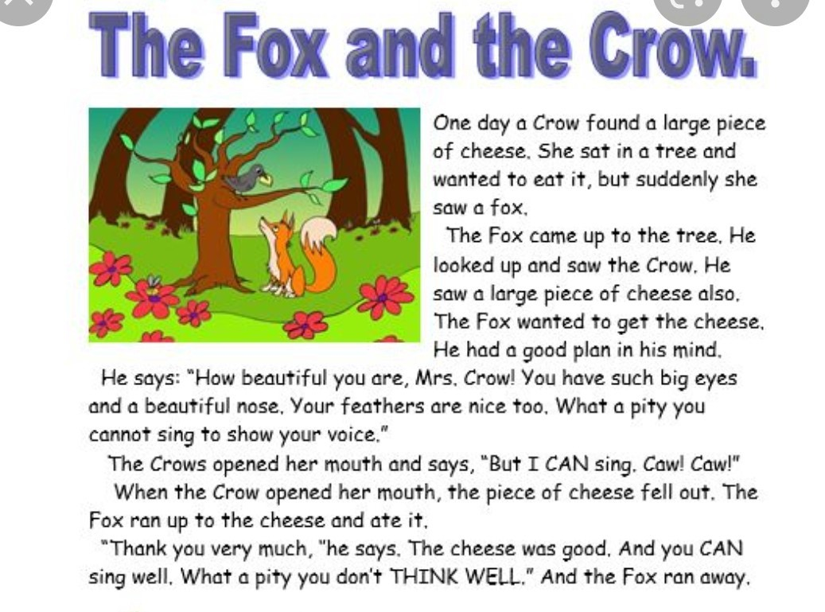
Read a story with proper intonation.

Slide 8

Speech Deliverance
Be a Good Speaker.
Remember these few things when you speak:
Speak clearly.
Don't mumble.
Look at person/persons when you talk to them.
You should not be too loud or too soft, too fast or too slow.
Be polite, and pleasant.
Give a thought to the other person’s feelings and thoughts.
When you want to give speech:
Plan your Speech in advance.
Note the points and arrange them properly.
Rehearse the speech in your mind and go ahead.

Slide 9
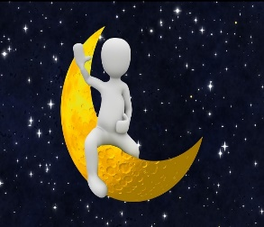
Activity: 2
I am dam excited to know about your happy birthday cake.
“Which flavour do you prefer?”
By the way… chocolate cake is my favourite one.
One more thing, please, don’t forget me while celebrating your birthday.
I am your dearest and favourite, aren’t I?
I think, I deserve my return gift with toffees and chocolates.
I know, you are very tired now.
Please, don’t be too late tomorrow.
I will be eagerly waiting for you tomorrow in our favourite place.
I am so happy and excited to look at your birthday dress and gifts.
Mind well, will not go to bed without your lullaby.
Bye, see you tomorrow!
Good night.
Hello, Chando Mama, How are you?
You are looking so bright and beautiful, anything special?
‘Is it your birthday today?’
Oh! Yes, great! Superb!!
Wish you many many happy returns of the day!
“So, what’s the plan of special day?”
Dear Mama, I know you live in the sky.
You must have invited all the twinkling stars.
They had definitely decorated your house brightly and beautifully.
Am I right....?
Yes, I know.

Slide 10
Homework:
Write and present speech on the following topics:
My friends
Hobbies
Favourite colour, dish, subject.
Likes and dislikes
Dream
What I want to be.....?

Slide 11
See the videoes of :
Malala - https://youtu.be/c2DHzlkUI6s
And
Sudha Murti- https://youtu.be/5sxbsa-O-D0
Reaction & Response = maturity
(Refer page No – 22 to 24 and page No-75)

